Slide 1
Digital Portfolio
STUDENT NAME: Monisha.s
REGISTER NO AND NMID: 2426j1524 and asbruaz2426j1524
DEPARTMENT: Bsc.Information Technology
COLLEGE: KPR College Of Arts Science And Research/Bharathiar
University

Slide 2
PROJECT TITLE:WEB DEVELOPMENT PORTFOLIO

Slide 3


AGENDA
Problem Statement
Project Overview
End Users
Tools and Technologies
Portfolio design and Layout
Features and Functionality
Results and Screenshots
Conclusion
Github Link
3/21/2024 Annual Review

Slide 4

PROBLEM STATEMENT:
Many students and professionals struggle to showcase their skills, projects, and achievements effectively. Traditional resumes are static and fail to demonstrate practical work. Hence, there is a need for a digital portfolio website that is interactive, accessible, and customizable.

Slide 5

PROJECT OVERVIEW
The project involves creating a personal web development portfolio that highlights academic achievements, projects, skills, certifications, and contact details. The portfolio will be responsive, user-friendly, and deployed online to serve as a professional identity.

Slide 6

WHO ARE THE END USERS?
Students – to showcase academic and project work.Job Seekers – to present skills and achievements to recruiters.Freelancers – to display services and past client work.Recruiters / Companies – to evaluate candidates quickly.

Slide 7

TOOLS AND TECHNIQUES
Frontend: HTML5, CSS3
JavaScriptFrameworks: Bootstrap / Tailwind
CSSVersion Control: Git,
GitHubDeployment: GitHub Pages / NetlifyOptional Add-ons: React.js (for advanced portfolio)

Slide 8
POTFOLIO DESIGN AND LAYOUT
Homepage → Introduction & taglineAbout Me → Education, skills, career goalsProjects Section → Details of major/minor projects with imagesCertifications & Achievements → Uploaded proofsResume Download Option → PDF linkContact Section → Email, LinkedIn, GitHub.
8

Slide 9
FEATURES AND FUNCTIONALITY
Responsive design (works on mobile, tablet, desktop)Interactive navigation menuProject showcase with images & live linksIntegrated GitHub repository linkContact form (with validation)Dark/Light mode (optional enhancement)

Slide 10

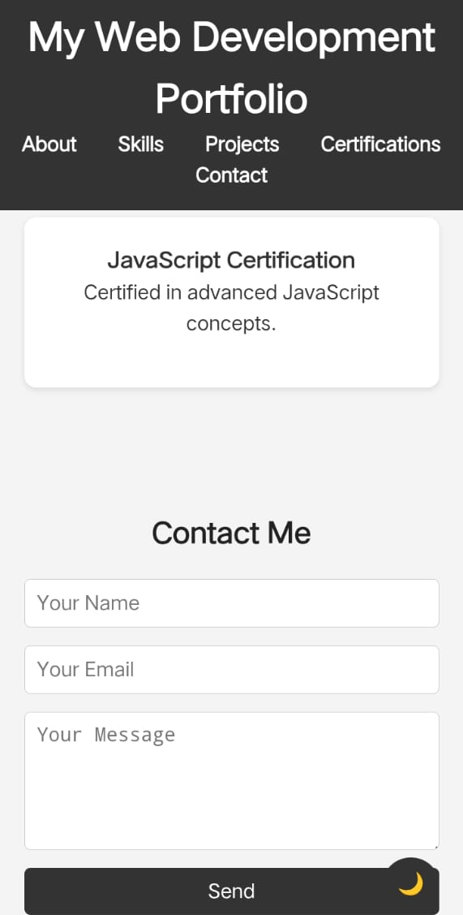
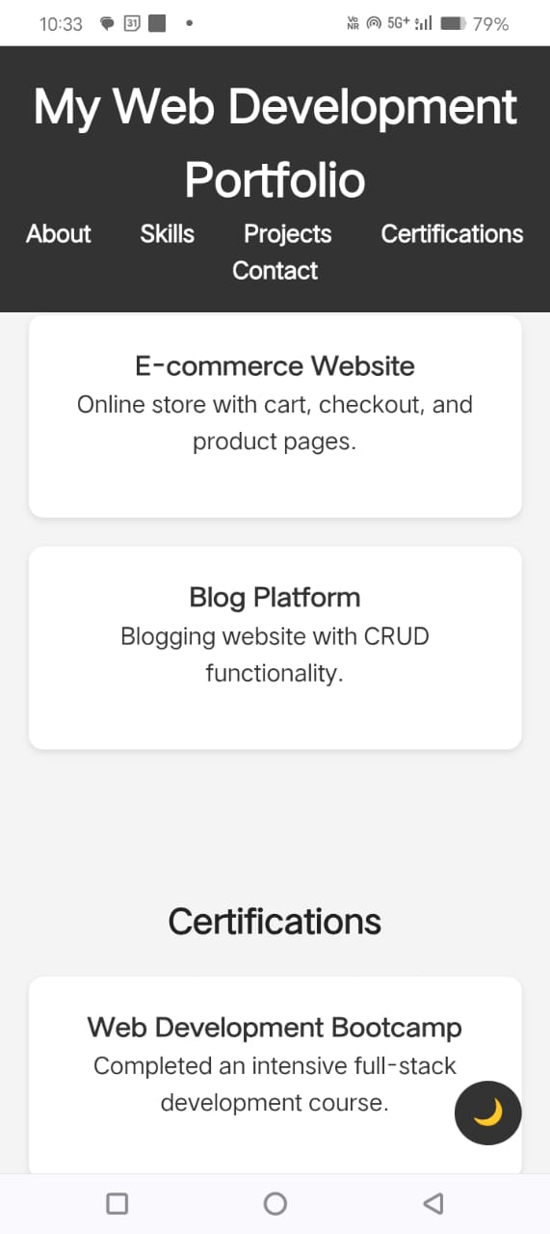
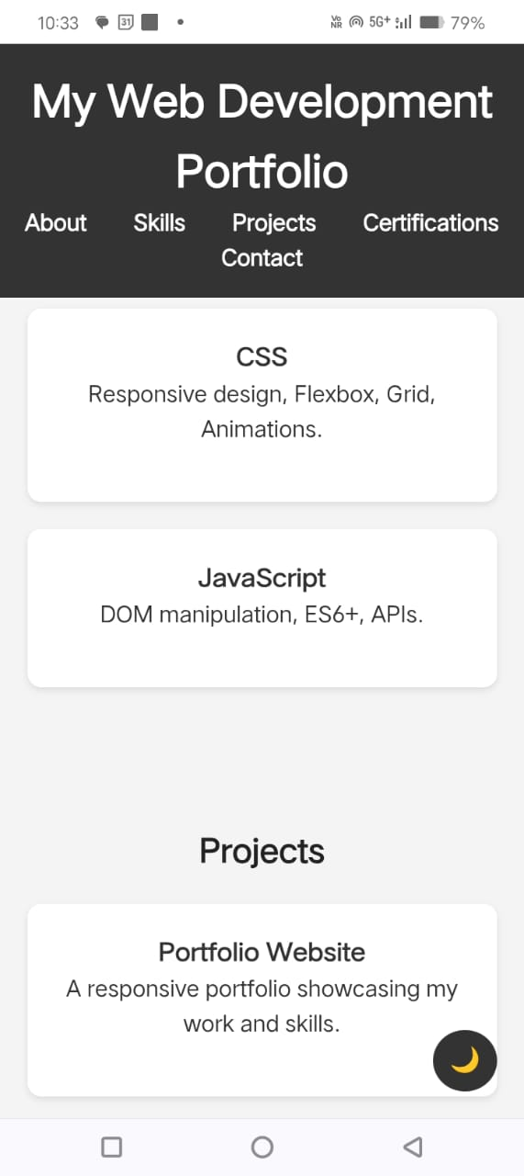
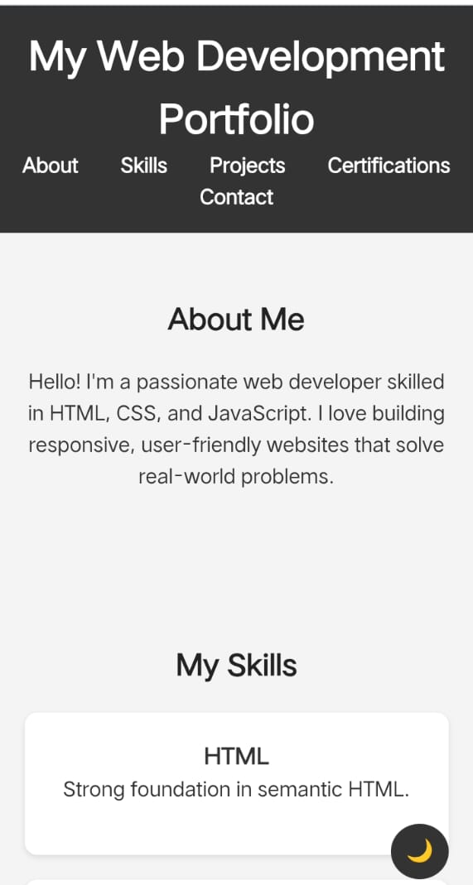
RESULTS AND SCREENSHOTS
3/21/2024 Annual Review
10

Slide 11
CONCLUSION
This web development portfolio provides an interactive way of showcasing personal and professional achievements. It enhances employability, builds a digital identity, and demonstrates practical web development skills.
11

